Slide 1
Java Mini Project (MP 1A)
Music Player And Recommendation app
(First Evaluation)
Group 13 Om Mahajan 5021129 Sahil Prasad 5021153 Shantaram Sawant 5021155
Guide Ms. Sharlene Rebeiro

Slide 2
Introduction
Our Java mini project group has 3 members Om Mahajan, Sahil Prasad, and Shantaram Sawant under Ms. Sharlene Rebeiro’s guidance. Our finalised idea for this mini project involves developing a better feature to get more accurate search results and better song recommendations. Any music app provides free and unlimited access to music online or download songs, but some features are not easy to work with, like when searching for an artist or a particular song, there are podcast recommendations, which are present only for more retention rate, and this was our main motivation to work on. It has enabled us to understand how popular music streaming apps work and fix those flaws that are not user-friendly. We aim to design a list of songs based on a user’s search that could be in the form of a table, which is much easier to work with.

Slide 3
Literature Survey
Related Works: 1) Music Recommendation System Based on Genre Distance and User Preference Classification [1]: In this method, the system analyses the usage patterns and consumption history of the user to recommend related songs to the user. But, this may lead to a Cold Start in the system leading to irrelevant recommendations.
2) Music and Movie Recommendation System [2]: In this method, the system classifies the songs based on the emotions they portray, but this might recommend also songs of all possible genres, which the user might not like, making the system less effective. The system might also recommend songs that the user dislikes.

Slide 4
Existing Systems: We’ve researched and analysed a few existing applications for their features and functionality. It goes as follows- 1) Music Player – Audio Player [3]: This music player application, developed by ‘Mobile_V5’, provides a great experience through its simple Graphic User Interface. It takes manual input of local files on the device and plays them according to the user’s requirement. Pros- 1. 5 band equalizer 2. Edit the song details 3. Notification status support
Cons- 1. No recommendation system available 2. Only available on android and iOS devices

Slide 5
2) Custom Music Player [4]: This music player is an open-source web application, developed by Mr Abhishek Tiwari, using scripting languages like HTML, CSS and JAVASCRIPT. Its GUI provides simple features such as Play, Pause and Skip. Pros- 1. Simple and minimalistic GUI
Cons- 1. Very small music database 2. Fewer features 3. No recommendation system available

Slide 6
Comparison:
Existing System | Year | Publisher | Limitations | Our advantage over the existing system
Music Player – Audio Player | 2013 | Mobile_VS | No recommendation system is available | Music Recommendation based on Listening activity
Custom Music Player | 2021 | Abhishek Tiwari | Very less features and small music data Lack of recommendation system | Searching the database for songs is possible

Slide 7
Scope: The app can be used for recreational purposes as music can help reduce stress and improve memory
Objective: To develop a "Music Player and Recommendation System" to recommend music to the user based on the type of music and the artist they’re listening to, in an organized way in tables.
Problem Statement: To develop a feature to solve the issue of irrelevant search results and give an appropriate recommendation based on listening activity.

Slide 8
Software requirements: 1. Front-end: HTML, CSS, Javascript, Frameworks (if required) 2. Back-end: MySQL, Java, Java Servlet 3. Other: VS Code, MS Office, SQL Server
Hardware requirements: 1. Modern Computer

Slide 9
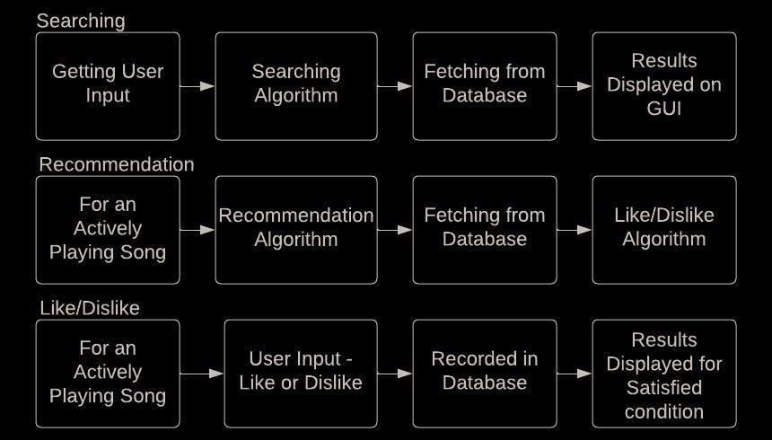
Data Flow Diagram:

Slide 10
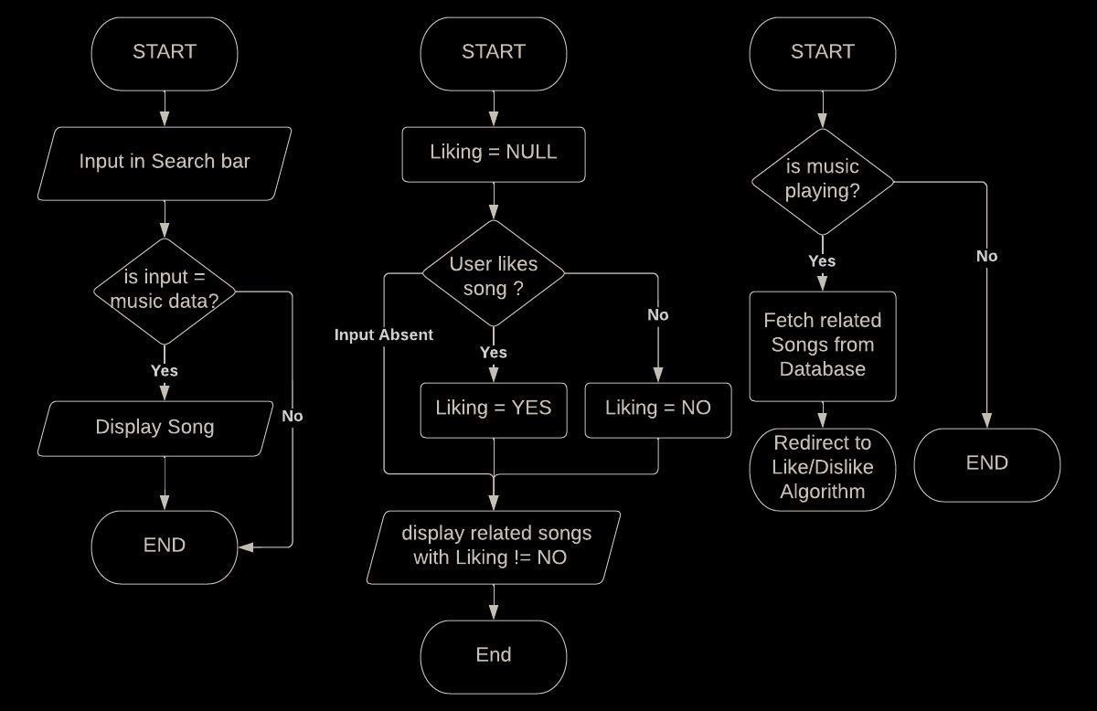
Flow Chart:

Slide 11
References:
[1] Jongseol Lee, Kyoungro Yoon, Dalwon Jang, Sei-Jin Jang, Saim Shin, Ji-Hwan Kim. “Music Recommendation System Based on Genre Distance And User Preference Classification” from the Journal of Theoretical And Applied Information Technology. (2018) [2] Puja Deshmukh and Geetanjali Kale. “Music and Movie Recommendation System” from the International Journal of Engineering Trends and Technology. (2018) [3] https://play.google.com/store/apps/details?id=media.music.musicplayer (2013) [4] https://github.com/abhishekptiwari/Custom-music-player (2021)

Slide 12
Thank You

